Slide 1
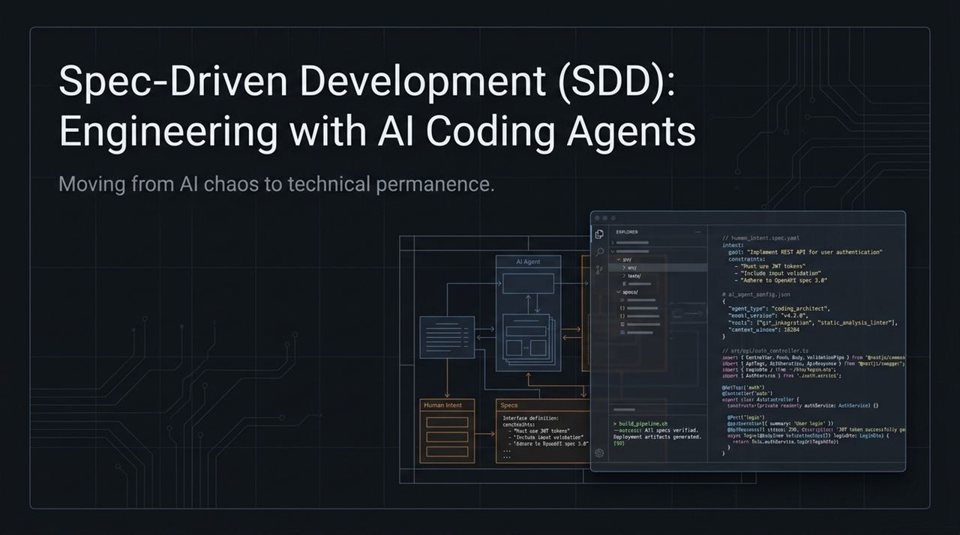
Notes:
Welcome, everyone. Today, we’re going to discuss one of the most critical transformations happening in software engineering right now: how we bridge the gap between AI coding agents and long-term technical architecture.
Over the past two years, AI tools have fundamentally shifted how code is generated. We went from basic code completion to autonomous agents capable of writing hundreds of lines of code in seconds. However, as teams adopt these agents, they quickly run into a wall. The initial speed boost often degrades into architectural chaos, unmaintainable codebases, and relentless debugging sessions.
This presentation introduces Spec-Driven Development (SDD)—a structured paradigm that moves us from 'AI chaos' to 'technical permanence'.
Look at the architecture on this slide. On the left, we start with Human Intent. As software engineers and architects, our primary job isn't typing syntax line-by-line anymore; it's defining precise intent, business goals, and constraints.
In the middle, that intent is formalized into Specs—structured, machine-readable, human-editable files written in plain markdown. These specs define interface contracts, security guidelines, and test criteria.
On the right, the AI Agent reads these exact specifications alongside its system instructions and executes the code. Finally, the output goes through a Build Pipeline, where tests and linters verify that the generated code satisfies 100% of the spec before anything touches production.
By the end of this session, you will understand why high-level chat prompting fails at scale, how SDD decouples intent from implementation, and how you can apply this exact workflow to build resilient, maintainable software with AI coding agents.
Full Course: Spec-Driven Development with Coding Agents
https://www.youtube.com/watch?v=hy8UstR2NEg

Slide 2
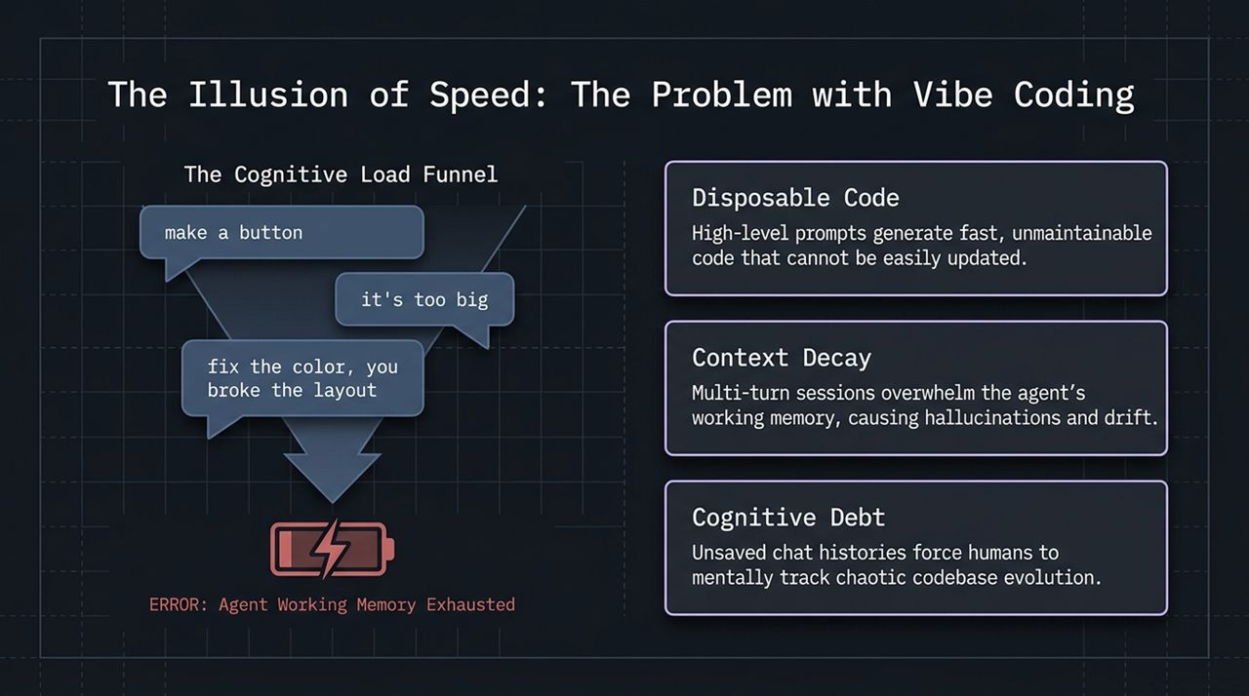
Notes:
Let's talk about how most people currently interact with AI models: an approach colloquially known as Vibe Coding.
Vibe coding is fast, fun, and feels magical at first. You open a chat window, type a quick prompt like 'make a button', and watch code appear. But what happens next?
You look at the UI and think, 'it's too big'. So you chat back: 'make it smaller.' Then you notice the styling is off: 'fix the color.' But in fixing the color, the AI unexpectedly breaks the grid layout. You reply: 'you broke the layout, fix it.'
This iterative chat loop is what we call The Cognitive Load Funnel. As you go deeper into a multi-turn chat session, three massive issues emerge:
Disposable Code: High-level, informal prompts generate code optimized only for immediate gratification. It lacks architectural thought. Six months later, nobody—including the AI—knows how to refactor or update it without breaking the entire component.
Context Decay: Every LLM operates within a context window. In multi-turn chat sessions, token counts explode with back-and-forth chatter, old code snippets, and error traces. This overwhelms the agent's working memory. As working memory gets filled with noise, the model experiences context rot, leading to hallucinations, regression bugs, and severe behavioral drift.
Cognitive Debt: When chat histories are discarded or buried inside an IDE panel, the mental model of why changes were made remains entirely in the human developer's head. The human becomes forced to track codebase evolution manually.
Vibe coding gives you the illusion of speed in minute 5, but charges compounding interest in technical debt by hour 5. To build systems that endure, we must abandon unstructured chat prompting and adopt a disciplined engineering framework.

Slide 3
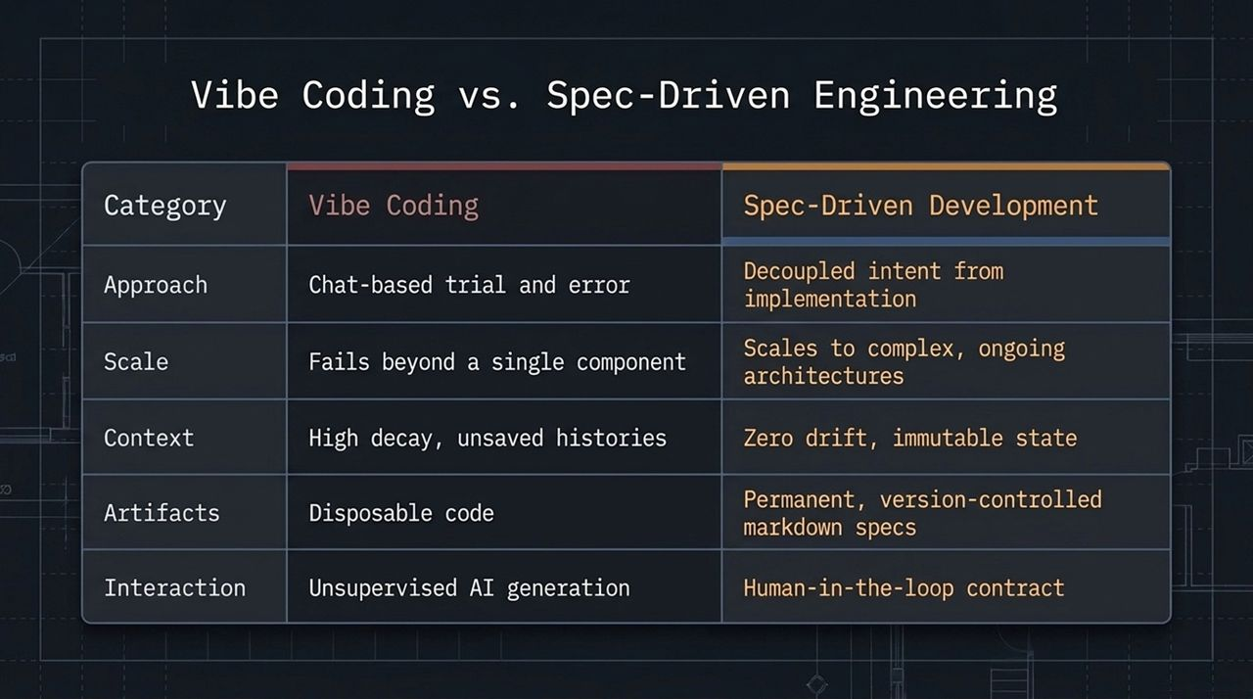
Notes:
To clearly highlight the paradigm shift, let's compare Vibe Coding directly against Spec-Driven Development across four key engineering dimensions.
First, Approach: Vibe coding relies on chat-based trial and error. You prompt, inspect, correct, and repeat. In contrast, SDD decouples intent from implementation. You spend your primary energy defining what needs to be built and why, long before you allow the agent to touch the source code.
Second, Scale: Vibe coding works decently well for standalone scripts, simple utility functions, or isolated UI prototypes. But as soon as you attempt to scale across multi-module systems, microservices, or complex backend logic, vibe coding breaks down completely. SDD scales seamlessly to complex, ongoing software architectures because every feature is anchored in a version-controlled specification.
Third, Context Artifacts: In vibe coding, context lives in volatile chat panels that suffer high context decay. Once you clear the chat session, that context is gone forever, leaving behind disposable code. In SDD, context is preserved in immutable, version-controlled markdown specifications (.md files) stored inside your repository. There is zero context drift because the spec lives right next to the code.
Fourth, Interaction: Vibe coding is unsupervised AI generation—you hope the AI makes the right technical assumptions. SDD establishes a strict Human-in-the-Loop contract. The human engineer acts as the Senior Architect who reviews and signs off on specifications before code execution begins.
SDD doesn't remove AI from the workflow; it elevates the human developer from a prompt guesser to a Software Architect.

Slide 4
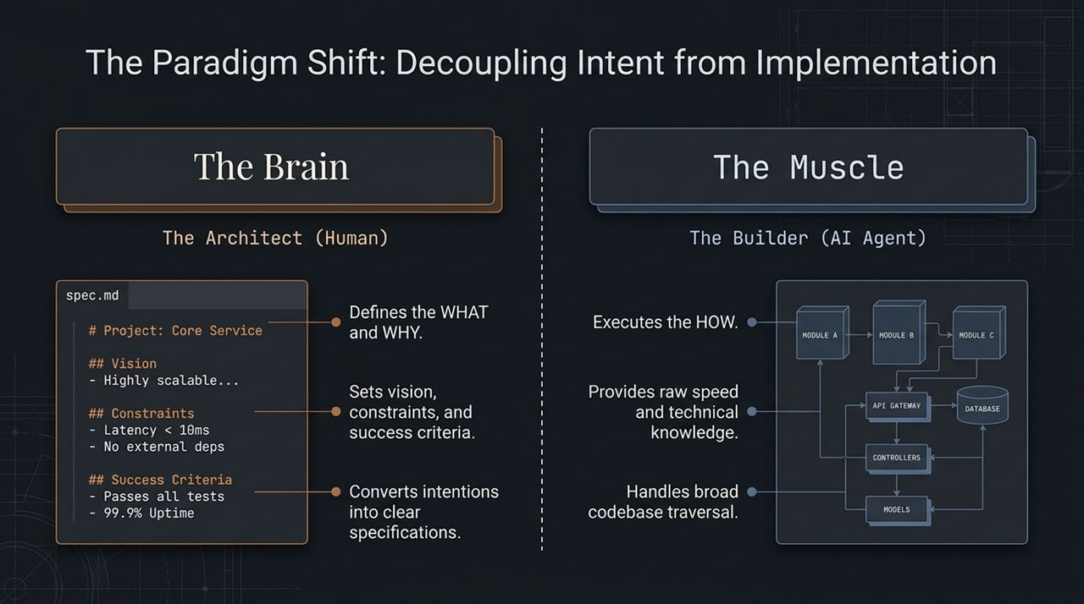
Notes:
The foundational principle of Spec-Driven Development is the total decoupling of Intent from Implementation.
In traditional software development, engineers handled both intent and implementation: we decided what to build, and then manually typed out every line of code. In vibe coding, we surrendered both to the AI, asking it to figure out what to do based on vague instructions.
SDD creates a clear division of labor based on core strengths:
'The Brain' is the Human Architect. As humans, our strength lies in business logic, system architecture, domain knowledge, and setting strict operational boundaries. We write the spec.md file. This file explicitly states:
The Vision: High-level architectural goals.
The Constraints: Latency limits (e.g., < 10ms), memory footprints, or strict stack rules (e.g., 'no external dependencies').
Success Criteria: Concrete, measurable conditions such as passing test suites and meeting uptime benchmarks.
'The Muscle' is the AI Agent Builder. AI models excel at raw execution speed, broad technical syntax retrieval, pattern matching, and traversing large codebases. When provided with an unambiguous spec, the AI agent constructs the underlying machinery—modules, API gateways, database schemas, controllers, and models—with precision.
When you separate the 'What and Why' from the 'How', you eliminate ambiguity. The AI isn't guessing your intentions anymore; it is acting as a highly efficient builder following a blueprinted engineering contract.

Slide 5
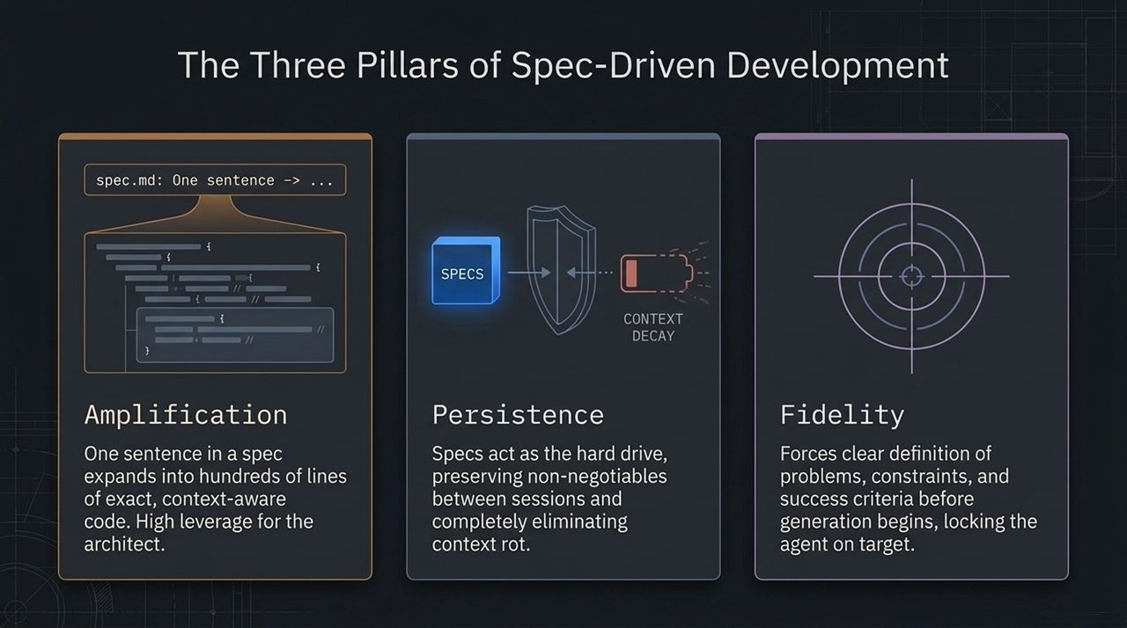
Notes:
Spec-Driven Development is built upon three core technical pillars: Amplification, Persistence, and Fidelity.
Let's start with Amplification. In SDD, a single, highly structured sentence in a specification file can amplify into hundreds of lines of exact, context-aware, boilerplate-free code. By operating at the specification layer, the architect achieves immense leverage. You no longer waste time correcting syntax or writing repetitive setup code; you direct high-level architectural output.
The second pillar is Persistence. One of the biggest flaws in existing LLM developer workflows is 'memory loss'. Chat sessions get reset, context windows fill up, and the AI forgets key project requirements. In SDD, specifications act as the persistent external hard drive for the agent. Because specs live in markdown files within the Git repository, non-negotiables are preserved across sessions, completely eliminating context rot. Whenever an agent starts a task, it reads the spec, ensuring 100% state retention.
The third pillar is Fidelity. Vibe coding suffers from 'target drift'—you ask for A, but by turn five of the chat, the AI has generated C. SDD forces developers to define problems, technical constraints, and acceptance criteria before code generation begins. This locks the AI agent on target, ensuring high alignment between human intention and machine execution.

Slide 6
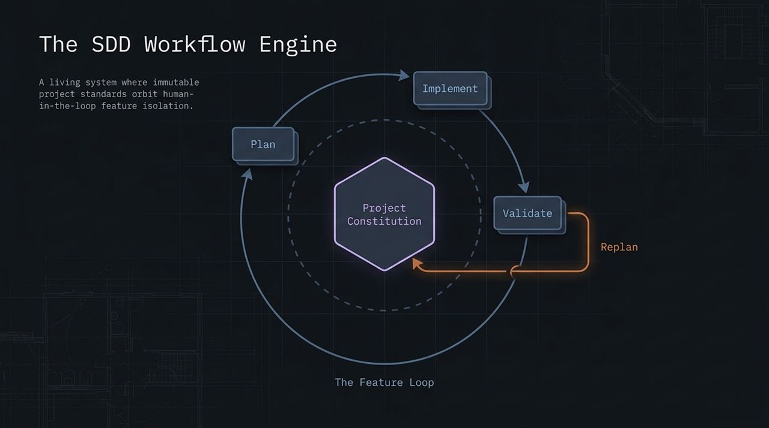
Notes:
Now that we understand the principles, let's explore the engine that drives SDD in actual daily engineering work.
The SDD workflow operates as an orbital system centered around a single core artifact: The Project Constitution.
The Project Constitution contains the permanent, immutable standards of your software project—things like your core tech stack, coding style guides, architectural rules, and long-term product vision.
Orbiting around this central constitution is The Feature Loop. Whenever you want to add a new feature, fix a bug, or refactor a module, you execute a four-step loop:
Plan: You isolate the feature in a branch and write a localized blueprint/spec defining requirements.
Implement: The AI agent executes the spec in small, targeted tasks.
Validate: Automated test suites and human inspection confirm the code matches the spec.
Replan: Any lessons learned or necessary architectural adjustments are cycled back to update the project specs.
Notice how structured this process is. Instead of letting the AI run wild across your entire repository, every change takes place within isolated feature loops guarded by the constitution.

Slide 7
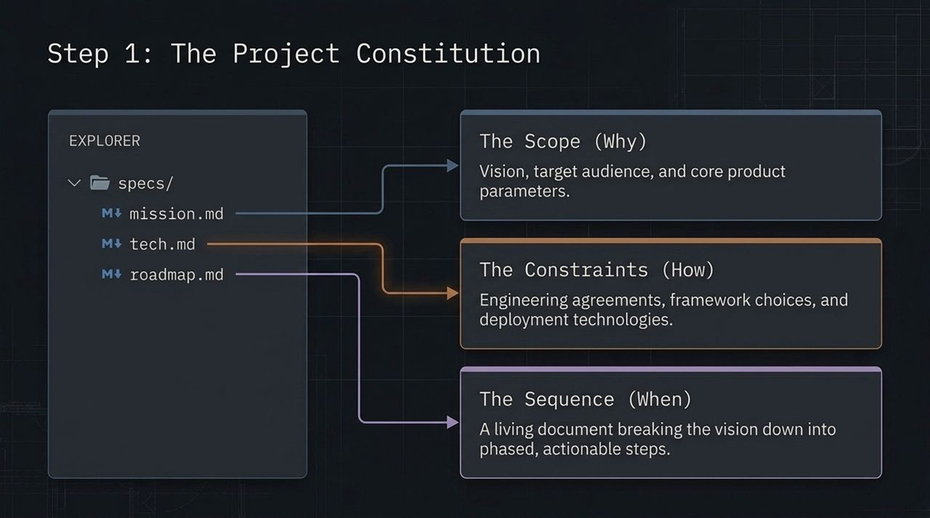
Notes:
Step 1 of implementing SDD is creating The Project Constitution.
Before you write a single line of application logic, you establish a /specs directory at the root of your project repository. This directory contains three primary markdown files:
mission.md (The Scope - Why): This document defines the high-level vision, target audience, business goals, and core product parameters. It answers why this application exists.
tech.md (The Constraints - How): This document captures all technical agreements, framework choices, database schemes, folder structures, linting rules, and deployment targets. It explicitly tells the agent: 'We use TypeScript, Next.js App Router, Tailwind CSS, and PostgreSQL. Do not introduce other libraries without permission.'
roadmap.md (The Sequence - When): A living document breaking the overarching product vision into phased, actionable engineering steps and milestones.
By establishing these three files, you provide your AI agent with complete context upfront. Whenever the agent runs, it reads this constitution to align its outputs with your project standards.

Slide 8
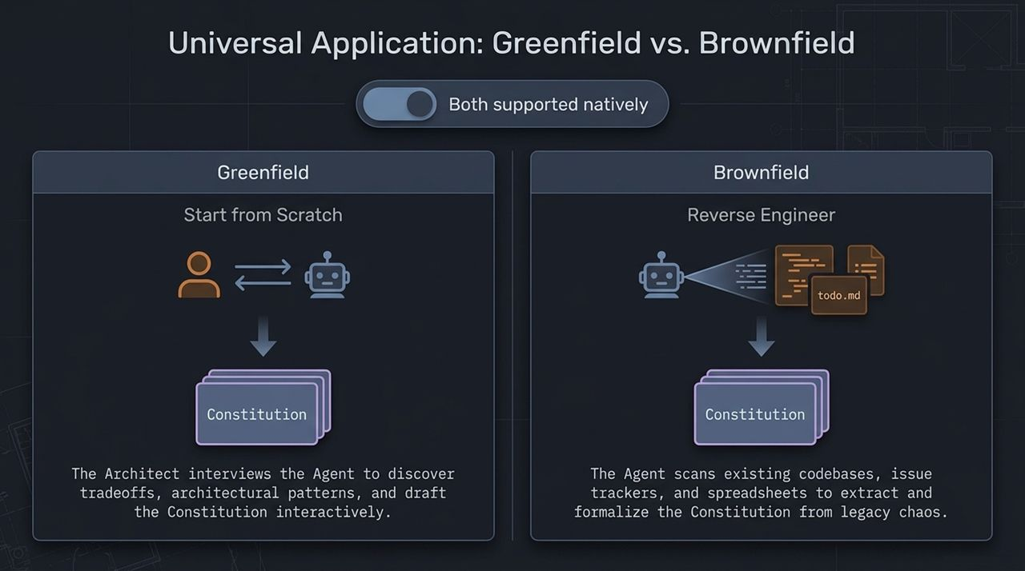
Notes:
A common question developers ask is: 'Does Spec-Driven Development only work for brand-new projects, or can I use it on existing codebases?'
The answer is that SDD natively supports both Greenfield (new) and Brownfield (legacy) projects.
In Greenfield Projects: You start from scratch. Here, the human architect conducts an interactive interview with the AI agent. You prompt the agent to ask you probing questions about architectural tradeoffs, performance requirements, and tech stack choices. Together, you interactively draft and refine mission.md, tech.md, and roadmap.md before generating code.
In Brownfield Projects: You inherit legacy chaos—undocumented code, outdated dependencies, and fragmented Jira tickets. In this scenario, you use the AI agent to reverse-engineer the constitution. You direct the agent to scan existing directories, package files, database schemas, and documentation. The agent extracts implicit architecture patterns and formalizes them into structured markdown specs.
Whether starting fresh or managing technical debt, establishing a constitution brings clarity and order to your development workflow.

Slide 9
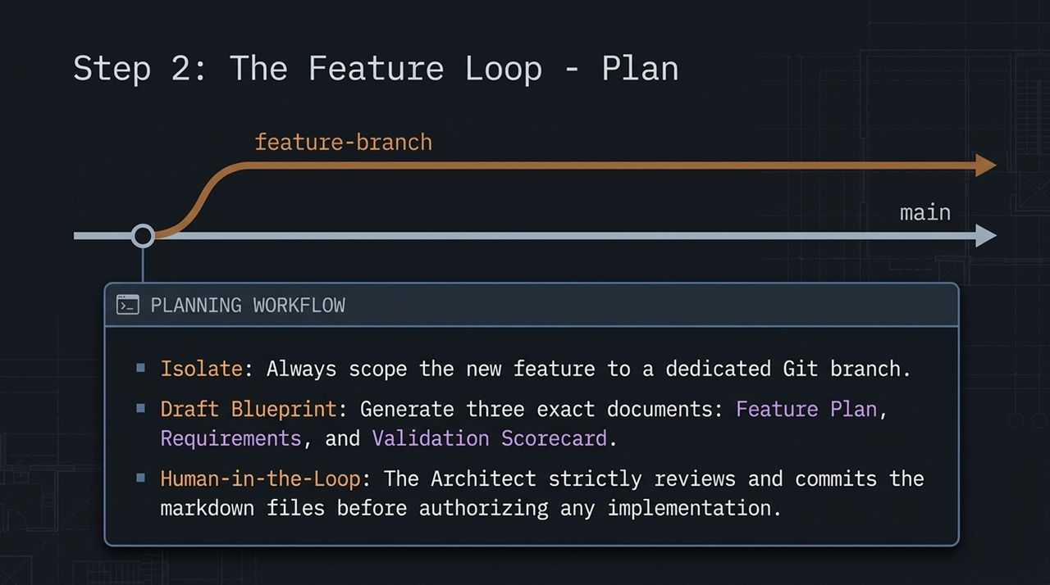
Notes:
Once your Project Constitution is in place, you enter The Feature Loop. Step 2 is Planning.
When a new feature request comes in, you never work directly on your primary branch or start chatting aimlessly. You follow a strict planning workflow:
Isolate: Always scope the new feature to a dedicated Git branch (e.g., feature/user-auth).
Draft Blueprint: Before writing implementation code, you direct the AI agent to generate three focused spec documents inside the feature branch:
Feature Plan: The step-by-step execution roadmap.
Requirements: Detailed user stories, edge cases, and API contracts.
Validation Scorecard: Clear criteria detailing how we will test and verify success.
Human-in-the-Loop Approval: This is critical. The human architect strictly reviews, edits, and commits these markdown specification files to Git before authorizing any code generation.
If you spot an error or missing requirement in the blueprint during planning, fixing it in markdown takes seconds. Catching that same mistake after generating 1,000 lines of code takes hours. Planning first guarantees high leverage.

Slide 10
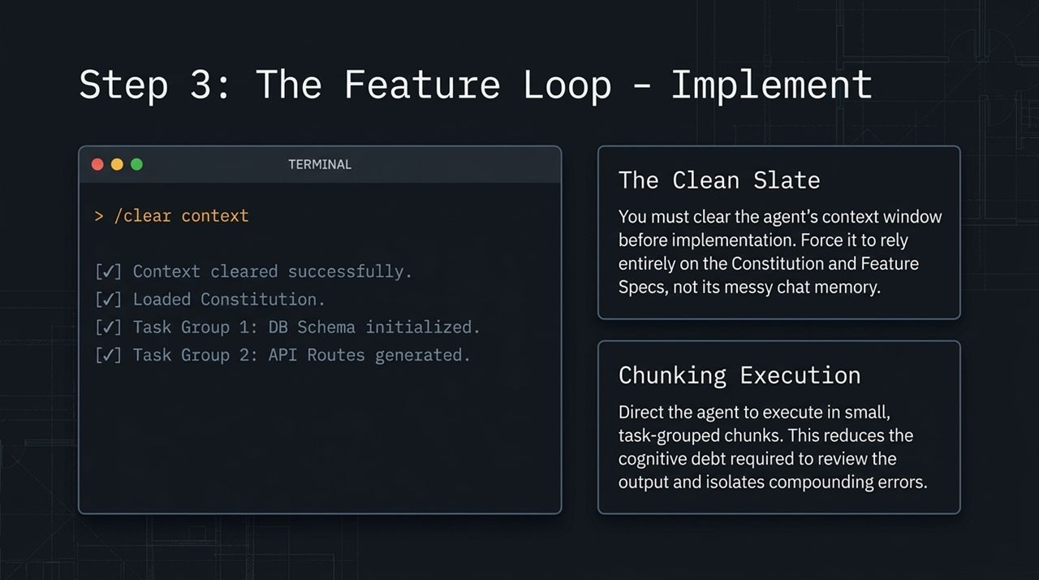
Notes:
With an approved feature spec committed to Git, we move to Step 3: Implementation.
This slide illustrates two essential rules for AI agent implementation:
Rule #1: The Clean Slate (/clear context). Before invoking the agent to write code, you clear its chat context window completely. Why? Because you want to eliminate all residual conversational noise, previous debugging attempts, and old assumptions. By clearing the context and referencing only the constitution.md and feature specs, you force the model to rely entirely on version-controlled truth rather than volatile chat memory.
Rule #2: Chunked Execution. Never ask an agent to implement an entire feature in a single massive step. Instead, direct the agent to execute in small, task-grouped chunks.
As shown in the terminal graphic:
Task Group 1: DB Schema initialized.
Task Group 2: API Routes generated.
Executing in chunks allows you to verify output incrementally, reducing cognitive fatigue and preventing small errors from compounding into larger system failures.

Slide 11
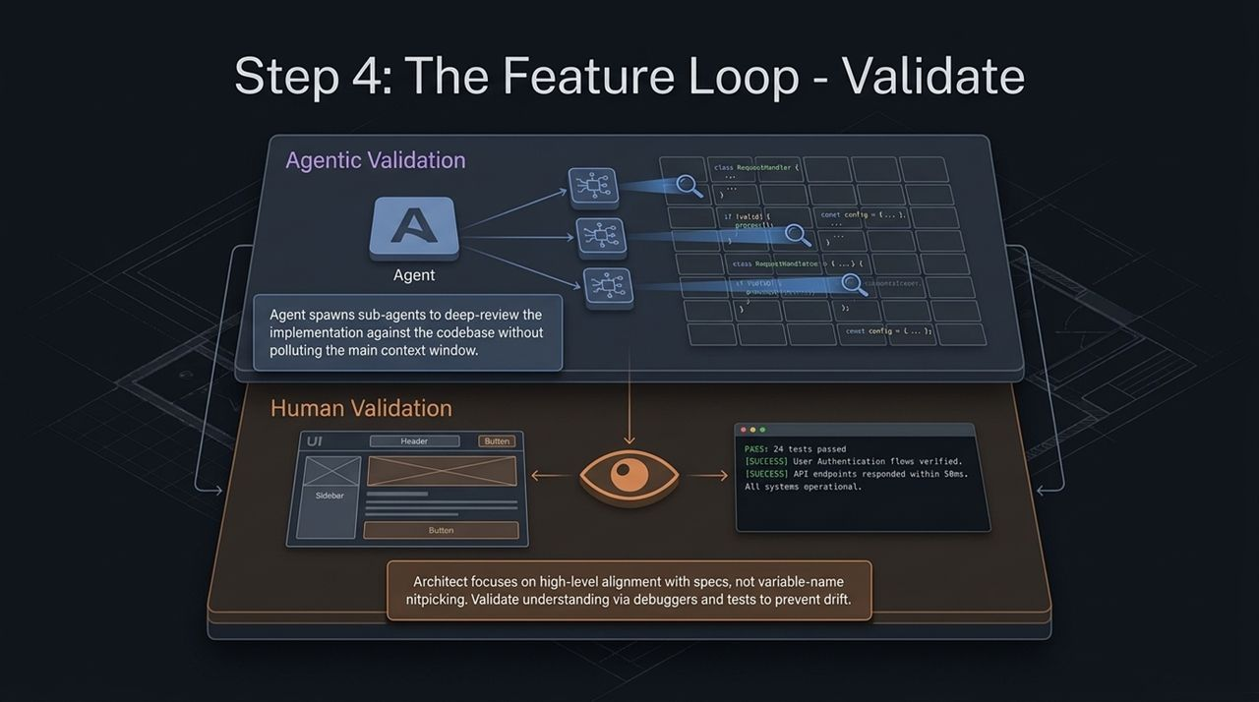
Notes:
Once implementation tasks are completed, we enter Step 4: Validation. Validation operates on two complementary layers: Agentic Validation and Human Validation.
Layer 1: Agentic Validation
Modern coding agents can spawn isolated sub-agents to perform automated code reviews. These sub-agents evaluate the newly generated code directly against the feature spec and project constitution. Because sub-agents run in isolated sub-tasks, they conduct thorough line-by-line checks without cluttering your main working context window.
Layer 2: Human Validation
Once agentic checks pass, the human architect steps in. Your goal as an architect is not to nitpick individual variable names. Instead, you focus on high-level alignment with business intent:
Do automated test suites pass? (e.g., '24 tests passed')
Do API endpoints satisfy latency requirements? (e.g., 'responded within 58ms')
Does the user interface function correctly?
By combining automated sub-agent reviews with human-driven validation, you ensure that delivered code meets functional and performance benchmarks.

Slide 12
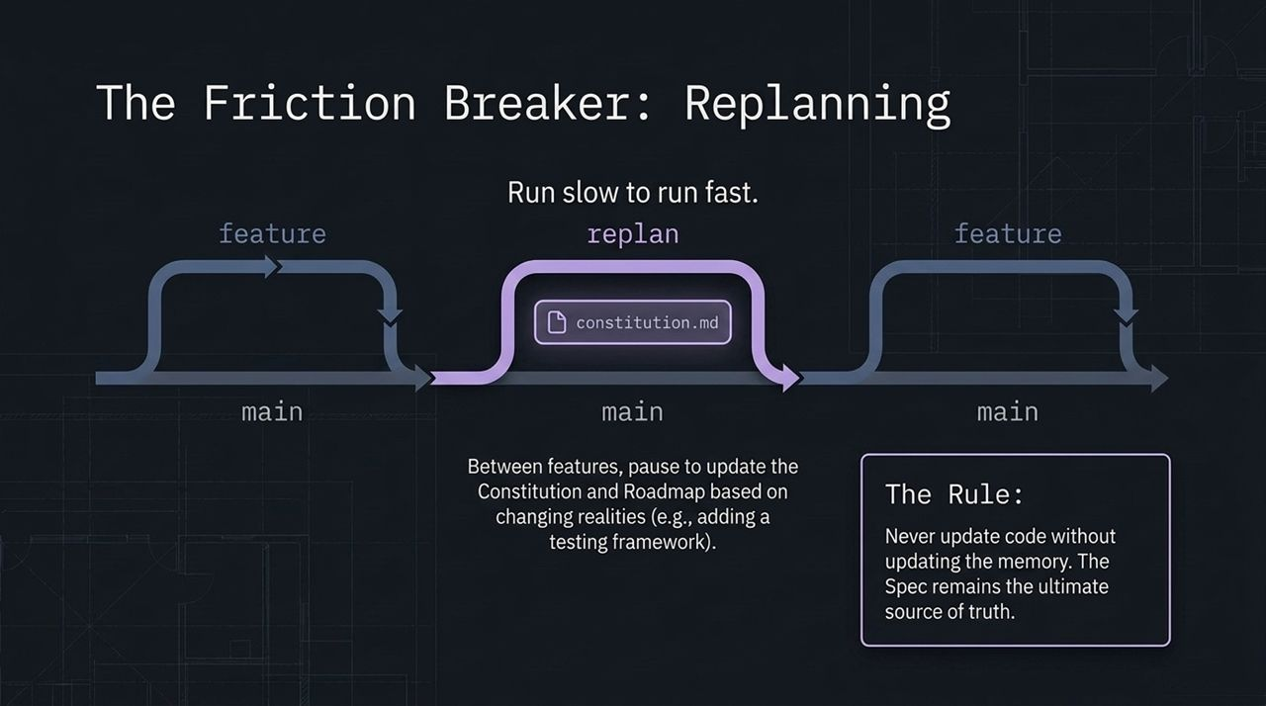
Notes:
Real-world development is rarely linear. As you build features, you discover new edge cases, third-party API quirks, or performance bottlenecks.
In vibe coding, developers apply hotfixes directly to source files. Over time, the code diverges from documentation, creating architectural drift.
In SDD, we use Replanning to resolve friction.
Whenever reality forces a change during development, we pause and update our memory artifacts. If we add a new testing framework or alter a database model, we update constitution.md and tech.md first.
This brings us to The Cardinal Rule of Spec-Driven Engineering:
'Never update code without updating the memory. The Spec remains the ultimate source of truth.'
If you change code without updating the spec, your AI agent will overwrite or break those changes during future feature cycles because its reference memory is out of date. By treating specs as living sources of truth, your codebase remains self-documenting and resilient.

Slide 13
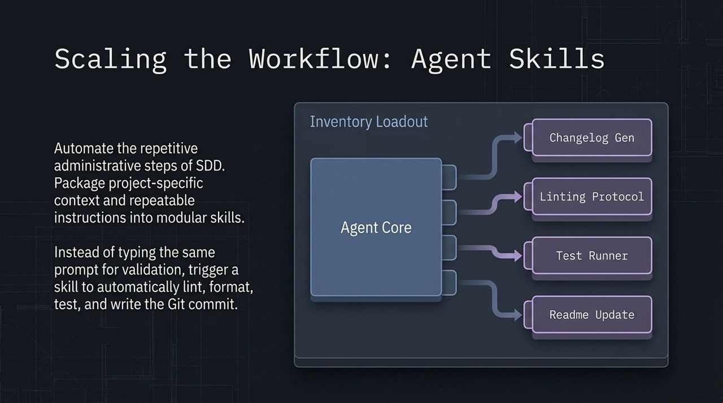
Notes:
As teams adopt SDD across larger codebases, manually instructing agents on setup steps, linting rules, and pull requests can become repetitive.
To scale SDD efficiently, we package project-specific workflows into Agent Skills.
Agent Skills are modular, reusable packages of custom instructions and commands that extend the capabilities of your AI agent.
Instead of typing multi-line prompts every time you finish a task, you trigger predefined skills:
Linting Protocol: Runs code style checks and formats files automatically.
Test Runner: Triggers unit and integration test suites, returning formatted failure reports to the agent.
Changelog Gen & Readme Update: Updates project documentation and commits standardized Git messages.
By codifying engineering standards into agent skills, you turn manual workflows into automated, repeatable routines across your entire development team.

Slide 14
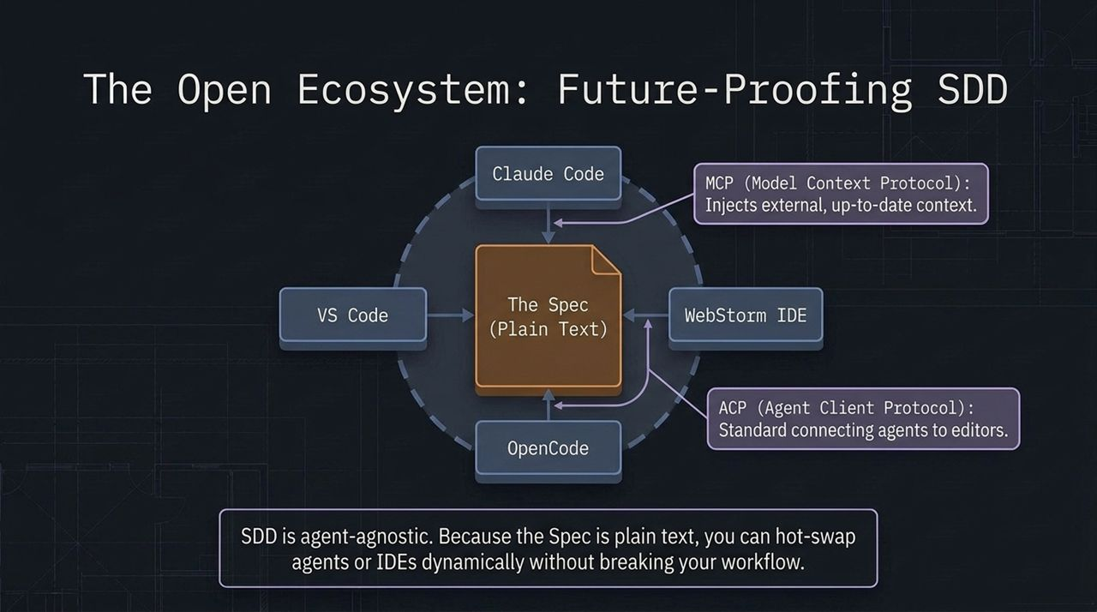
Notes:
A major strategic advantage of Spec-Driven Development is that it future-proofs your software against tool lock-in.
AI developer tools are evolving rapidly. A tool or model that leads the market today might be surpassed tomorrow. If your development workflow depends entirely on proprietary chat sessions or vendor-specific interfaces, switching tools can be difficult and costly.
Because SDD relies on plain-text markdown specifications stored in standard Git repositories, it is completely agent-agnostic.
Look at the open ecosystem on this slide:
The Spec (Plain Text) sits at the center as the universal source of truth.
Open standards like MCP (Model Context Protocol) allow agents to pull live context from external tools and databases.
Protocols like ACP (Agent Client Protocol) provide standardized connections between AI agents and modern IDEs like VS Code, WebStorm, Claude Code, or OpenCode.
If a more capable model or IDE comes out next month, you can swap your underlying AI engine without losing project memory or changing your core engineering workflow.

Slide 15
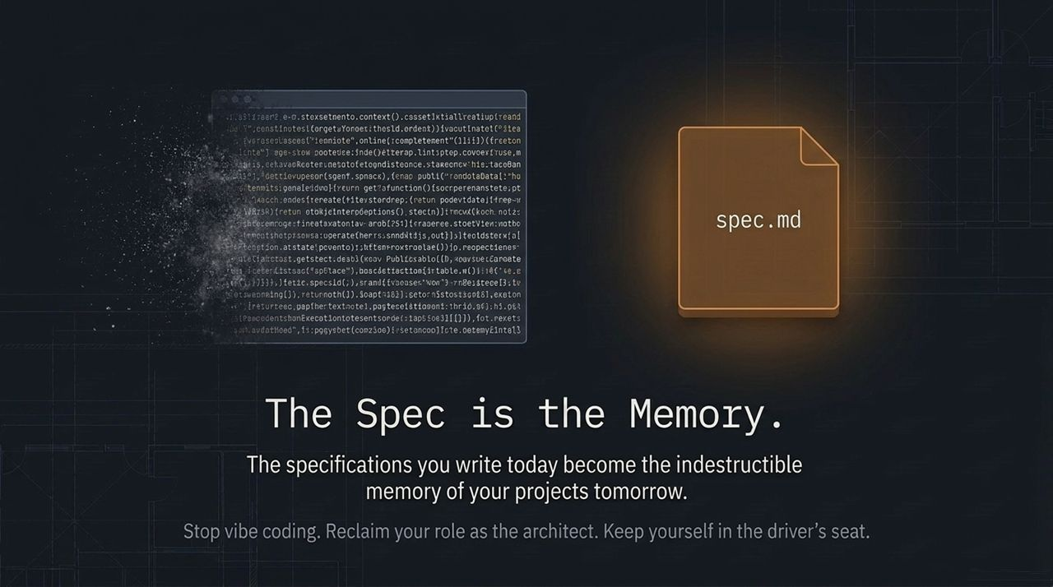
Notes:
To summarize our journey today: The Spec is the Memory.
When working with AI coding agents, source code is simply an implementation detail generated from specifications. The specs you write today become the indestructible memory of your projects tomorrow.
Vibe coding might offer quick wins for throwaway prototypes, but engineering complex, maintainable software requires structure, discipline, and clarity.
By adopting Spec-Driven Development:
You eliminate context decay and architectural drift.
You establish clear human-in-the-loop oversight.
You maintain total architectural control while leveraging AI execution speed.
Stop vibe coding. Reclaim your role as the architect, and keep yourself in the driver's seat.
Thank you!

Slide 16
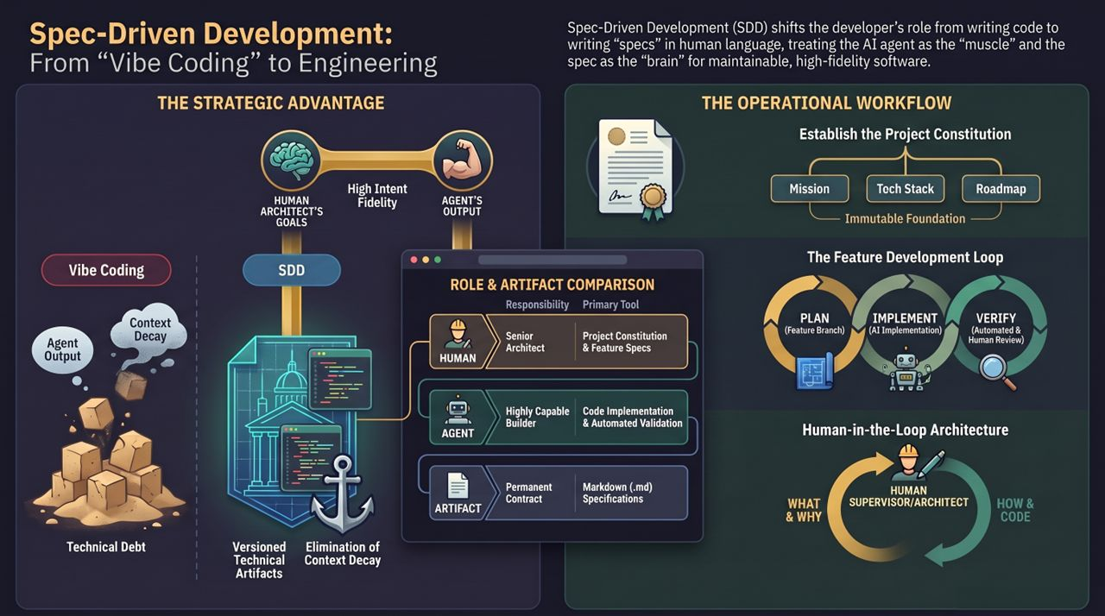
Notes:
This final reference slide serves as an executive summary of the entire Spec-Driven Development framework for team leads and engineering managers.
Let's do a final review of the key components:
Strategic Advantage: SDD transforms developers from manual coders into system architects. We use natural language specs to direct AI agents, treating human reasoning as the 'brain' and AI generation as the 'muscle'.
Operational Workflow: By replacing high-decay context loops with permanent Markdown (.md) specs, we eliminate technical debt caused by AI drift.
Roles & Responsibilities:
Senior Architect (Human): Owns the Project Constitution and Feature Specs. Focuses on What and Why.
Capable Builder (AI Agent): Owns Code Implementation and Automated Validation. Focuses on How.
The Core Workflow: Establish the Project Constitution (mission.md, tech.md, roadmap.md), then run the Feature Development Loop (Plan -> Implement -> Verify -> Replan).
Using this structure allows software teams to move fast with AI agents while maintaining rigorous engineering standards.
For a comprehensive video walkthrough explaining these core principles and demonstrating how coding agents utilize markdown specifications in real-world workflows, check out the Full Course on Spec-Driven Development with Coding Agents. This course provides step-by-step demonstrations on setting up project constitutions, executing feature loops, and packaging custom skills.
Full Course: Spec-Driven Development with Coding Agents
https://www.youtube.com/watch?v=hy8UstR2NEg

